Slide 1
EVALUATING AND MONITORING FORECASTING MODEL PERFORMANCE
Measure of Errors

Slide 2
“ Goodness of Fit” Vs "out-of-sample" forecast error
There are many statistical measures that describe how well a model fits a given sample of data.
This goodness-of-fit approach often uses the residuals and does not really reflect the capability of the forecasting technique to successfully predict future observations.
The user of the forecasts is very concerned about the accuracy of future forecasts, not model goodness of fit, so it is important to evaluate this aspect of any recommended technique.
Sometimes forecast accuracy is called "out-of-sample" forecast error, to distinguish it from the residuals that arise from a model-fitting process.

Slide 3
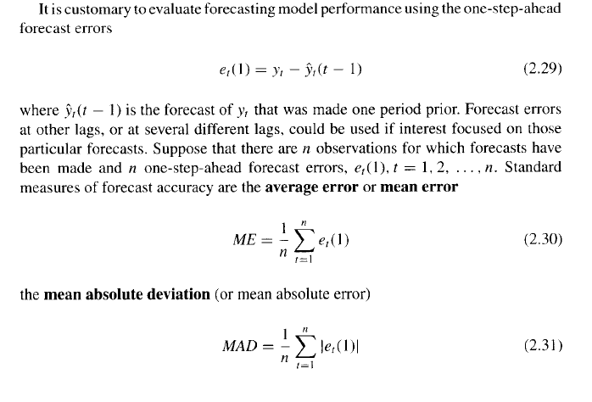
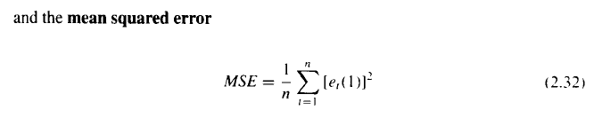
One-Step Ahead Forecasting Errors

Slide 4
Discussion: Errors
The mean forecast error (ME) is an estimate of the expected value of forecast error, which we would hope to be zero; that is- the forecasting technique produces unbiased forecasts.
If the mean forecast error differs appreciably from zero, bias in the forecast is indicated.
If the mean forecast error drifts away from zero when the forecasting technique is in use, this can be an indication that the underlying time series has changed in some fashion, the forecasting technique has not tracked this change, => and now biased forecasts are being generated.
Both the mean absolute deviation (MAD) and the mean squared error (MSE) measure the variability in forecast errors.
Obviously, we want the variability in forecast errors to be small.
The MSE is a direct estimator of the variance of the one-step-ahead forecast errors.

Slide 5
Relative forecast error
The one-step-ahead forecast error and its summary measures, the ME, MAD, and MSE, are all scale-dependent measures of forecast accuracy: that is - their values are expressed in terms of the original units of measurement (or in the case of MSE the square of the original units).
So, for example, if we were forecasting demand for electricity during the summer, the units would be megawatts (MW). If the MAD for the forecast error during summer months was 5 MW, we might not know whether this was a large forecast error or a relatively small one.
Furthermore, accuracy measures that are scale dependent do not facilitate comparisons of a single forecasting technique across different
time series, or
time periods.
To accomplish this, we need a measure of relative forecast error.

Slide 6
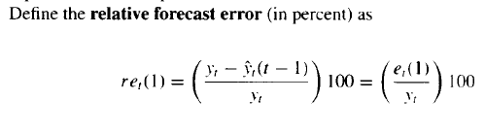
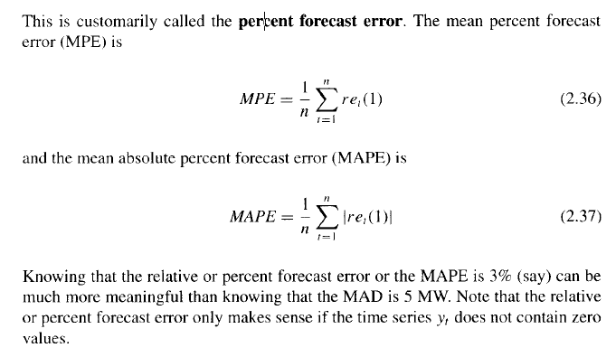
Relative Percent Errors

Slide 7
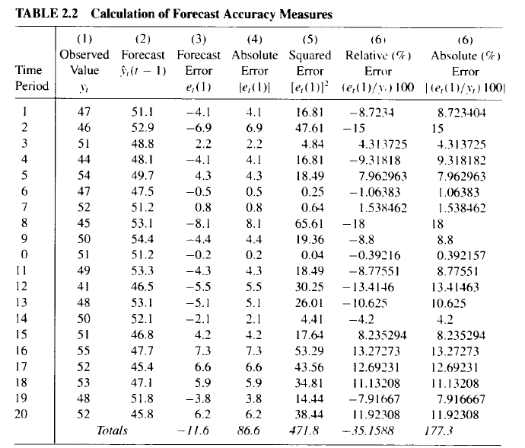
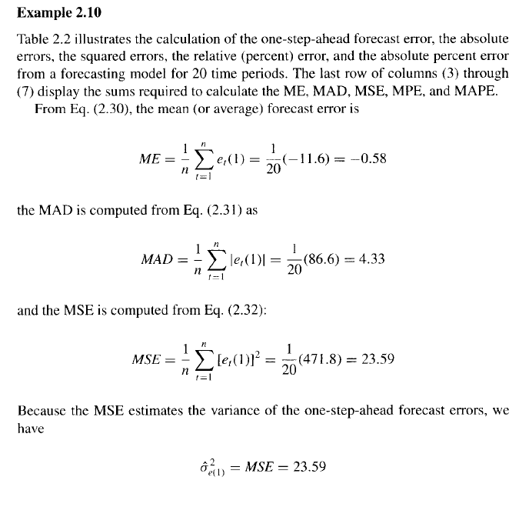
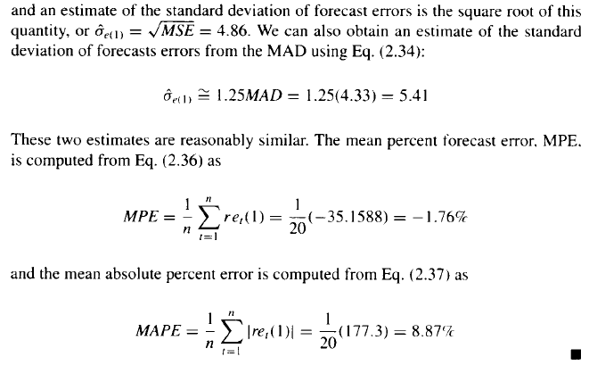

Slide 8
Choosing Between Competing Models

Slide 9
Cross-validation/ out-of-sample forecast
There are often several competing models that can be used for forecasting a particular time series. For example, there are several ways to model and forecast trends.
Consequently, selecting an appropriate forecasting model is important.
Selecting the model that provides the best fit to historical data generally does not result in a forecasting method that produces the best forecasts of new data.
Concentrating too much on the model that produces the best historical fit often results in overfitting, or including too many parameters or terms in the model just because these additional terms improve the model fit.
In general, the best approach is to select the model that results in the smallest standard deviation (or mean squared error) of the one-step-ahead forecast errors when the model is applied to data that was not used in the fitting process.
Refer to this as an out-of-sample forecast error standard deviation (or mean squared error). A standard way to measure this out-of-sample performance is by utilizing some form of data splitting; that is, divide the time series data into two segments-one for model fitting and the other for performance testing. Sometimes data splitting is called cross-validation.

Slide 10
Cross-validation/ out-of-sample forecast
A good rule of thumb is to have at least 20 or 25 observations in the performance testing data set.
When evaluating the fit of the model to historical data, there are several criteria that may be of value.

Slide 11
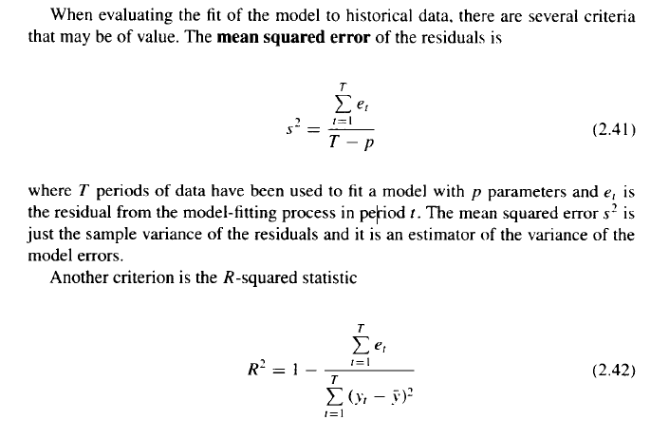
MSE and R Squared

Slide 12
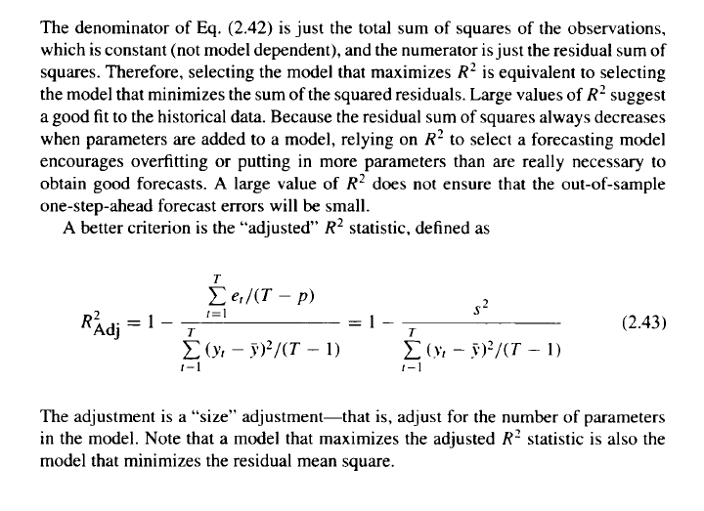
R Squared and Adjusted R Squared

Slide 13
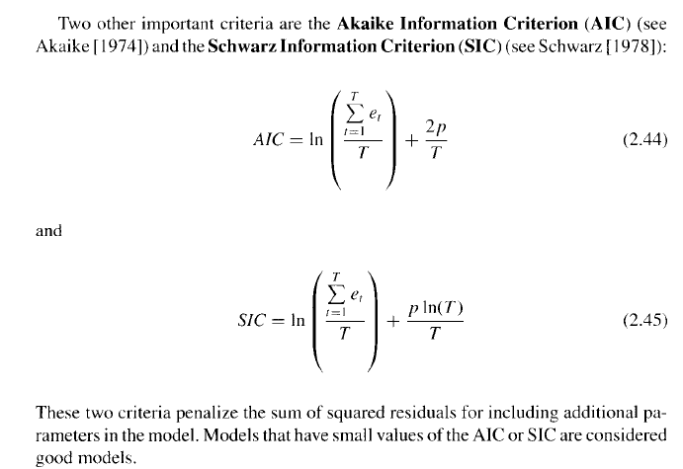
AIC and SIC
Models that have small values of the AIC or SIC are considered good models.

Slide 14
Conclusion
Many software packages evaluate and print model selection criteria, such as those discussed here. When both AIC and SIC are available, prefer using SIC.
It generally results in smaller, and hence simpler models, and so its use is consistent with the time-honored model-building principle of parsimony (all other things being equal, simple models are preferred to complex ones, Occam’s Razor).
The best way to evaluate a candidate model's potential predictive performance is to use data splitting. This will provide a direct estimate of the one-step-ahead forecast error variance, and this method should always be used, if possible, along with the other criteria discussed above.
Occam’s Razor:-14th century friar William of Ockham that says that if you have two competing ideas to explain the same phenomenon, you should prefer the simpler one.

Slide 15
